Slide 1

Time-Series Forecasting
LSTM Model

Slide 2

Time-series forecasting models
models capable of predicting future values based on previously observed values i.e., they are autoregressive
widely used for non-stationary data.
the mean and standard deviation are not constant over time but instead, these metrics vary over time.

Slide 3

Long short-term memory (LSTM)
An artificial recurrent neural network (RNN) architecture used in the field of deep learning.
LSTM has feedback connections.
LSTM models can store information over a period of time.
Lstm-forget gate-dictate how much to forget
set of gates that regulate the flow of information in and out of the memory cell.

Slide 4
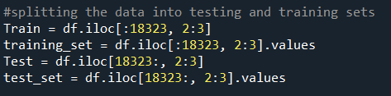
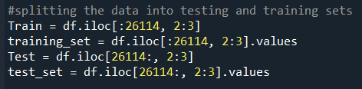
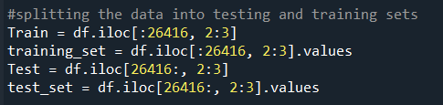
Train-Test
Data are split into 75% train and 25% test

Slide 5
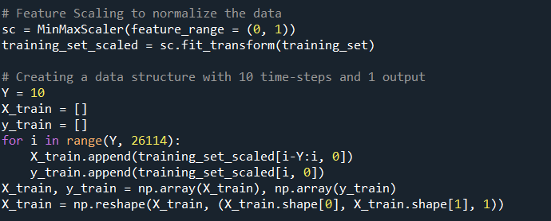
Feature scaling is done to normalize the data
Brings all the features to same scale
Improves model accuracy and prediction
iteration of the loop creates a sequence of 10- time steps as the input and the corresponding next value as the output.

Slide 6
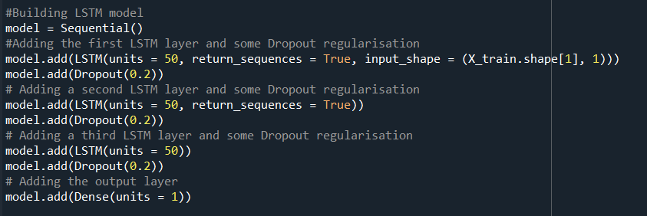
Building LSTM Model
Sequential initialize the model
3 LSTM layers
Dropout to prevent overfitting

Slide 7
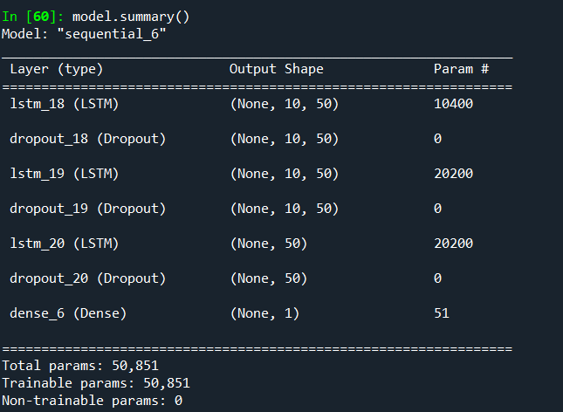
Model Architecture

Slide 8
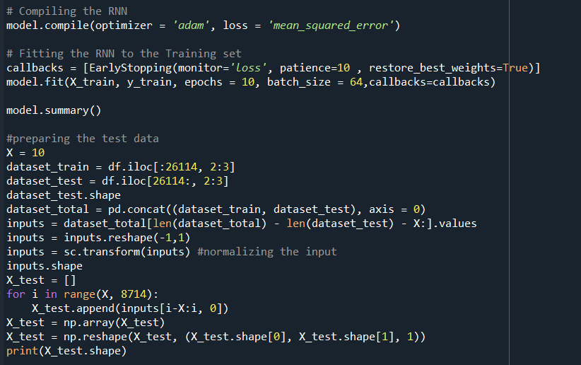
Optimizer- Adams
Loss function – mean squared error
Fit trains the model
Epochs – 10
Early Stopping callback
Batch-size = 64
Preparing test data i.e., input for prediction

Slide 9
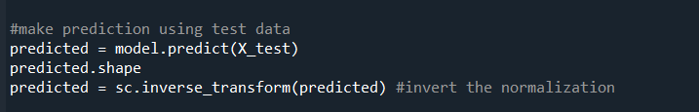
make predictions on the test data
inverting the normalization to get the predicted values in the original scale

Slide 10
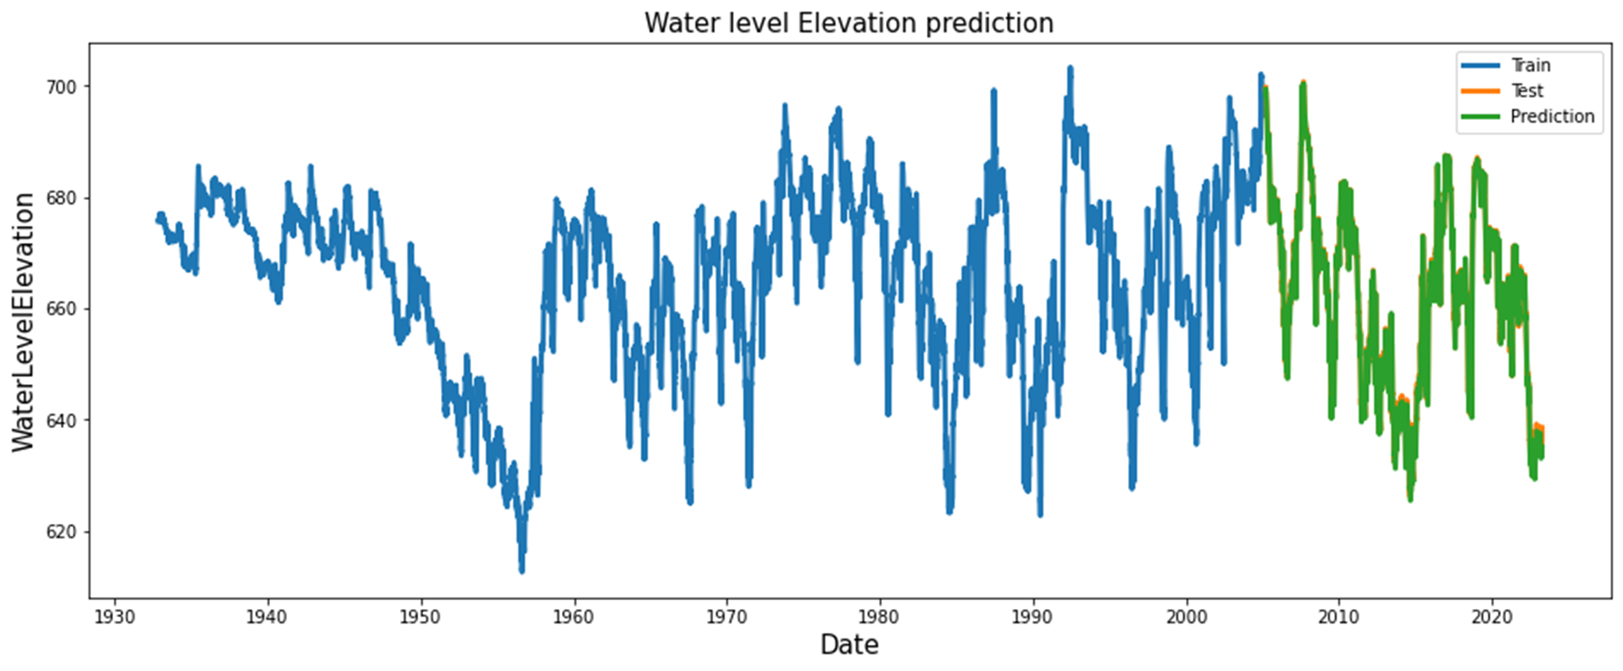
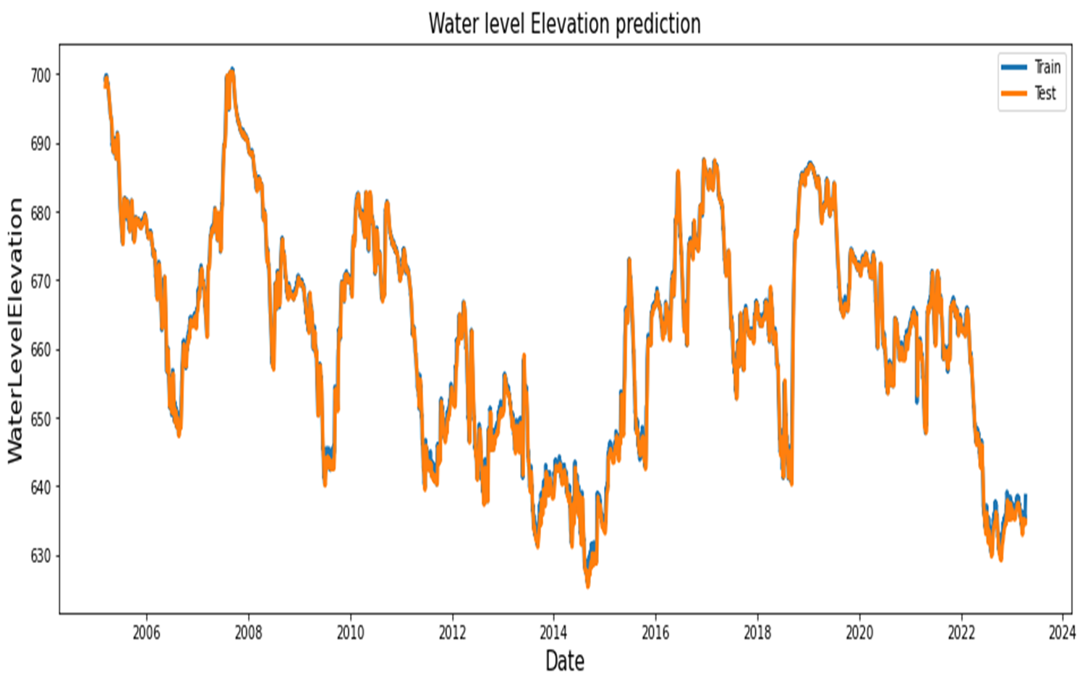
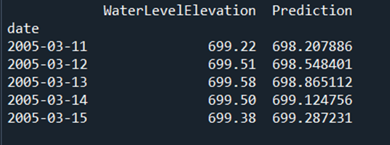
Bexar Index Well (J-17)

Slide 11
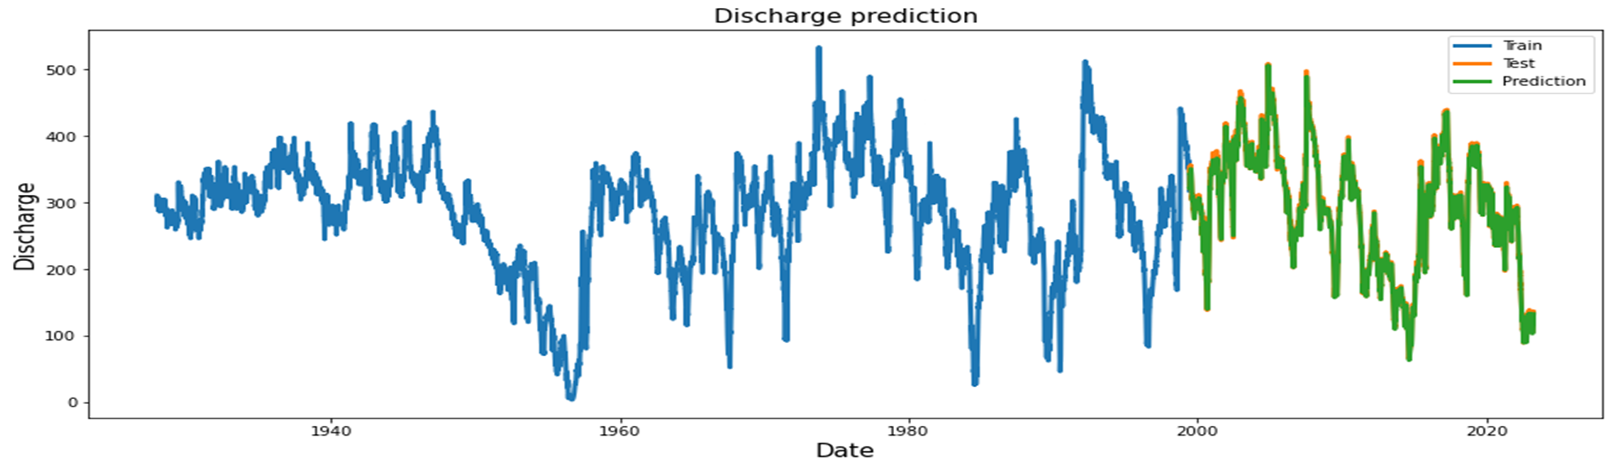
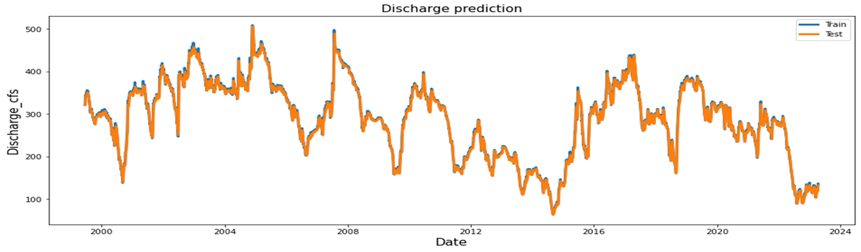
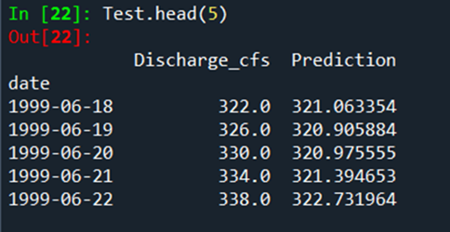
Comal Spring

Slide 12
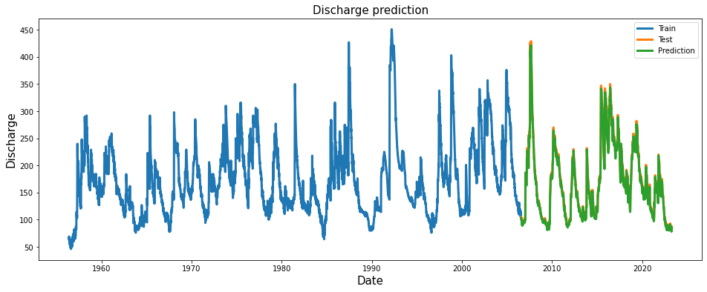
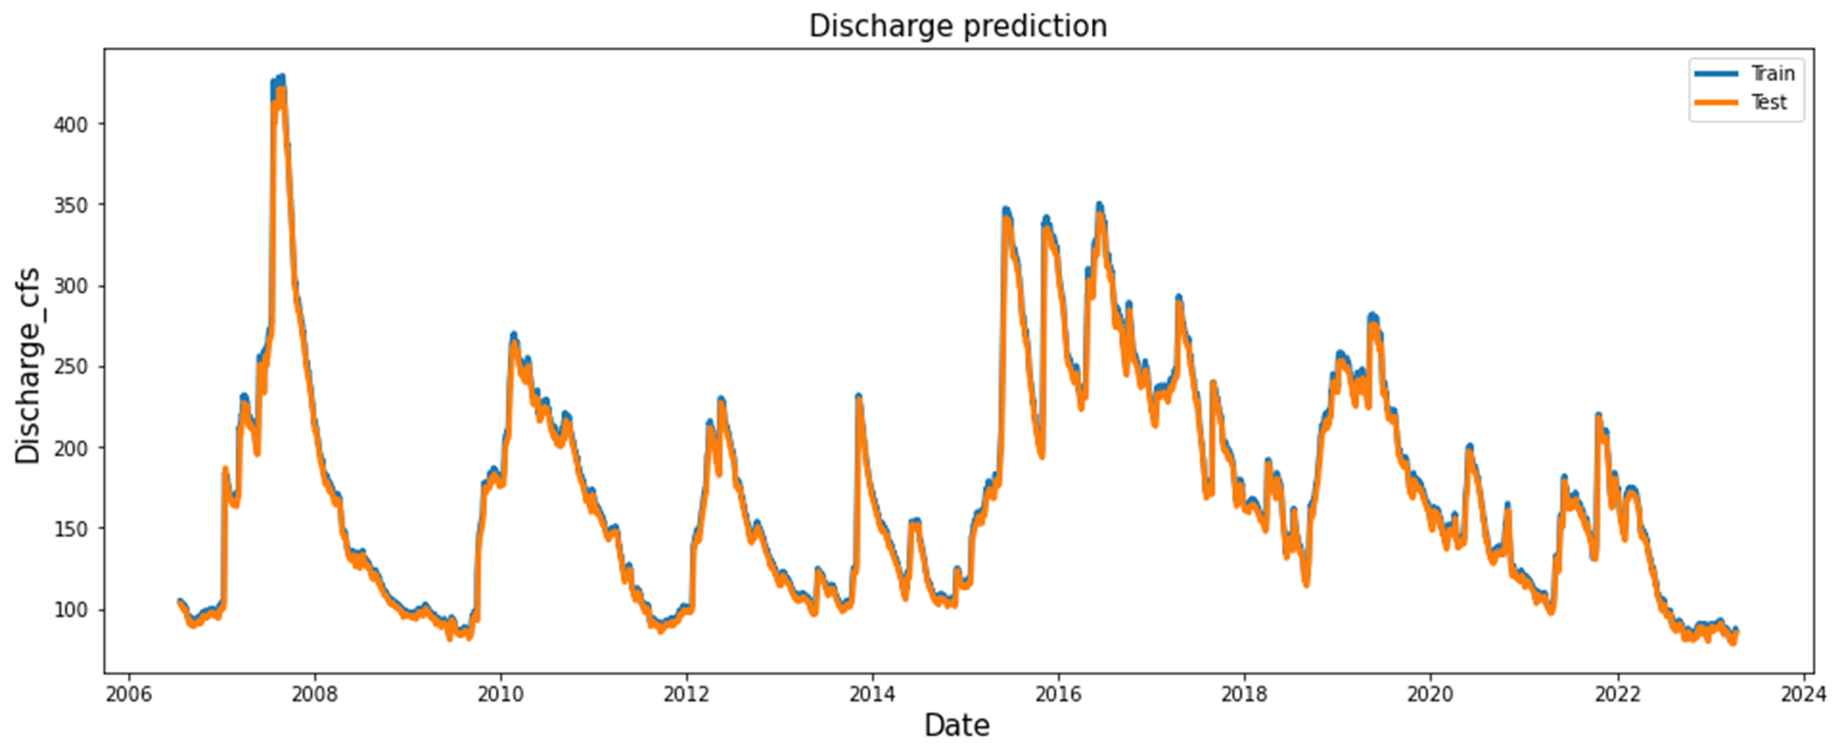
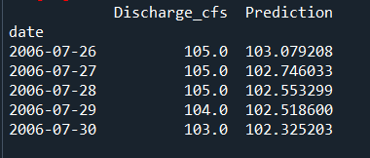
Spring San-marcos

Slide 13
References
https://towardsdatascience.com/lstm-time-series-forecasting-predicting-stock-prices-using-an-lstm-model-6223e9644a2f

